Slide 1
Murach’s Modern JavaScript
Chapter 13
How to work with modules

Slide 2
Objectives
Applied
Export and import items from an ES module.
Declare a script as a module.
Rename imports and exports.
Import and export classes.
Create a default export.
Use an import map.
Knowledge
Describe three benefits of using modules.
Recognize closures, IIFEs, and the module pattern in legacy code and understand how they work.

Slide 3
A module that exports three functions
const scores = []; // private variable
export function addTestScore(score) {
scores.push(score);
}
export function getAverageScore() {
let total = 0;
for (let score of scores) {
total += score;
}
return total / scores.length;
}
export function getScoreDisplayString(separator = ", ") {
return scores.join(separator);
}
Another way to export the three functions
export {addTestScore, getAverageScore,
getScoreDisplayString};

Slide 4
A module that uses two of the exported functions
import {addTestScore, getScoreDisplayString}
from "./lib_test_scores.js";
const getElement = selector =>
document.querySelector(selector);
getElement("#add_score").addEventListener("click", () => {
const score = parseFloat(getElement("#score").value);
addTestScore(score);
getElement("#all").textContent =
getScoreDisplayString();
// const len = scores.length;
// ReferenceError: scores is not defined
});

Slide 5
Two <script> elements that declare modules
<script src="lib_test_scores.js" type="module"></script>
<script src="test_scores.js" type="module"></script>

Slide 6
A <script> element that declares inline JavaScript as a module
<script src="lib_test_scores.js" type="module"></script>
<script type="module">
import {addTestScore, getScoreDisplayString}
from "./lib_test_scores.js"
const getElement = selector =>
document.querySelector(selector);
getElement("#add_score").addEventListener(
"click", () => {
const score =
parseFloat(getElement("#score").value);
addTestScore(score);
getElement("#all").textContent =
getScoreDisplayString();
});
</script>

Slide 7
A module…
Keeps variables, constants, and functions out of global scope.
Prevents name conflicts.
Can create private state for an object.
A module…
Must be run from a server.
Uses strict mode automatically.
Uses the defer attribute of the <script> element automatically.
Is only executed once.
Is imported into the scope of a single script.

Slide 8
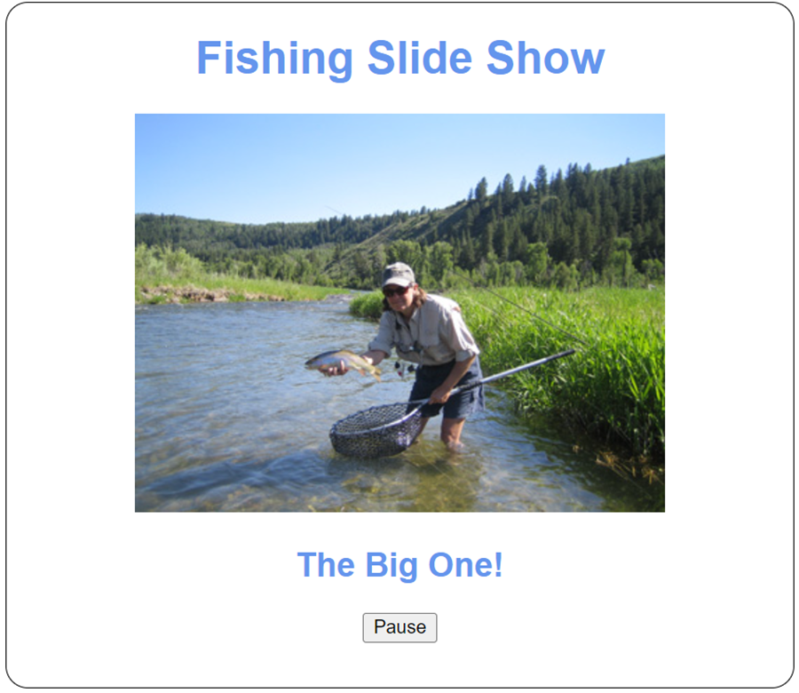
The Slide Show app

Slide 9
The <body> element for the Slide Show app
<body>
<h1>Fishing Slide Show</h1>
<p><img id="image"></p>
<h2 id="caption"></h2>
<p><input type="button" id="pause_resume"
value="Pause"></p>
<script src="lib_slide_show.js" type="module">
</script>
<script src="lib_DOM.js" type="module"></script>
<script src="slide_show.js" type="module"></script>
</body>

Slide 10
The lib_DOM.js file
export function getElement(selector) {
return document.querySelector(selector);
}

Slide 11
The lib_slide_show.js file (part 1)
// private variables/constants
let timer = null;
let running = true;
let speed = 2000;
const nodes = {image: null, caption: null};
const img = {cache: [], counter: 0};
// private functions
function stopSlideShow() {
clearInterval(timer);
}
function displayNextImage() {
img.counter = ++img.counter % img.cache.length;
const image = img.cache[img.counter];
nodes.image.src = image.src;
nodes.image.alt = image.alt;
nodes.caption.textContent = image.alt;
};

Slide 12
The lib_slide_show.js file (part 2)
// public functions
function loadImages(slides) {
for (let slide of slides) {
const image = new Image();
image.src = "images/" + slide.href;
image.alt = slide.title;
img.cache.push(image);
}
}
function startSlideShow(image, caption) {
if (image && caption) {
nodes.image = image;
nodes.caption = caption;
}
displayNextImage();
timer = setInterval(displayNextImage, speed);
}

Slide 13
The lib_slide_show.js file (part 3)
function getToggleHandler() {
return evt => {
if (running) {
stopSlideShow();
} else {
startSlideShow();
}
const button = evt.currentTarget;
button.value = (running) ? "Resume" : "Pause";
running = !running; // toggle running flag
};
}
export {loadImages, startSlideShow, getToggleHandler};

Slide 14
The slide_show.js file (part 1)
import {getElement} from './lib_DOM.js';
import {getToggleHandler, loadImages,
startSlideShow} from './lib_slide_show.js';
document.addEventListener("DOMContentLoaded", () => {
// define slides
const slides = [
{href:"release.jpg", title:"Catch and Release"},
{href:"deer.jpg", title:"Deer at Play"},
{href:"hero.jpg", title:"The Big One!"},
{href:"bison.jpg", title:"Roaming Bison"}
];
// attach event handler for Pause/Resume button
getElement("#pause_resume").addEventListener(
"click", getToggleHandler());

Slide 15
The slide_show.js file (part 2)
// load images and start slide show
loadImages(slides);
startSlideShow(getElement("#image"),
getElement("#caption"));
});

Slide 16
How to rename imports
import {loadImages as slideShowLoadImages,
startSlideShow as slideShowStart}
from './lib_slide_show.js';
How to rename exports
export {loadImages as load,
startSlideShow as start,
getToggleHandler as getToggle};

Slide 17
How to create and use a module object
import * as slideShow from './lib_slide_show.js';
...
const slides = [...];
slideShow.load(slides);
slideShow.start($("#image"), $("#caption"));
...

Slide 18
How to export classes
export {Trip, Trips};
class Trip {...}
class Trips {...}
How to import classes
import {Trip, Trips} from './lib_trips.js';
...
const trips = new Trips();
const trip = new Trip("Seattle", 100, 3.5);
...
Code that declares the two files that use the classes as modules
<script src="lib_trips.js" type="module"></script>
<script src="trips.js" type="module"></script>

Slide 19
A module file with a default export
export default function getElement(selector) {
return document.querySelector(selector);
}
Import the default export
import get from './lib_DOM.js';
// no braces, different name

Slide 20
A module file with a default export that’s an anonymous function and two named exports
const scores = [];
export default (score) => scores.push(score);
export function getAverageScore() {...}
export function getScoreDisplayString(separator = ", ") {...}
Import the default export and a named export
import addScore, {getAverageScore}
from './lib_test_scores.js';

Slide 21
A <script> element with an import map
<script type="importmap">
{
"imports": {
"dom": "../general_modules/DOM.js",
"trip":"./modules/trip.js",
"dayjs": "https://cdn.skypack.dev/dayjs@1.10.7",
}
}
</script>
An import statement that uses a module specifier from the import map
import {Trip} from 'trip';

Slide 22
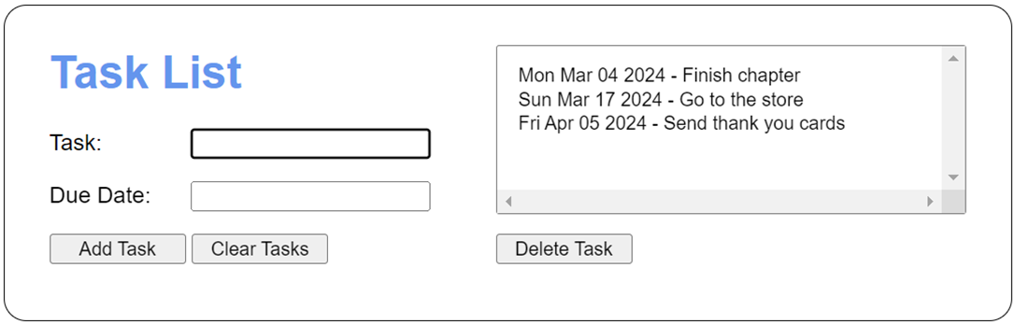
The Task List app

Slide 23
The <script> elements for the Task List app
<script type="importmap">
{
"imports": {
"storage": "../general_modules/storage.js",
"DOM": "../general_modules/DOM.js",
"task":"./modules/task.js",
"task_storage":"./modules/task_storage.js",
"task_list":"./modules/task_list.js"
}
}
</script>
<script src="task_list.js" type="module"></script>

Slide 24
The general_modules/storage.js file
function retrieve(key) {
const json = localStorage.getItem(key);
if(json) {
return JSON.parse(json);
} else {
return null;
}
}
function store(key, data) {
localStorage.setItem(key, JSON.stringify(data));
}
function remove(key) {
localStorage.removeItem(key);
}
export {retrieve, store, remove};

Slide 25
The general_modules/DOM.js file (part 1)
function get(selector) {
return document.querySelector(selector);
}
function setText(selector, text) {
get(selector).textContent = text;
}
function setValue(selector, value) {
get(selector).value = value;
}
function getValue(selector) {
return get(selector).value;
}
function clear(selector) {
const elem = get(selector);
if (elem.value) elem.value = "";
else elem.textContent = "";
}
function focus(selector) {
get(selector).focus();
}

Slide 26
The general_modules/DOM.js file (part 2)
function select(selector) {
get(selector).select();
}
function load(func) {
document.addEventListener("DOMContentLoaded", func);
}
function addClick(selector, func) {
get(selector).addEventListener("click", func);
}
export {get, setText, setValue, getValue, clear,
focus, select, load, addClick};

Slide 27
The modules/task.js file
class Task {
constructor(description, dueDate) {
this.description = description;
this.dueDate = new Date(dueDate);
}
get hasInvalidDueDate() {
return this.dueDate.toString() ===
"Invalid Date";
}
get isPastDue() {
const today = new Date();
return this.dueDate.getTime() < today.getTime();
}
toString() {
return `${this.dueDate.toDateString()} –
${this.description}`;
}
}
export default Task;

Slide 28
The modules/task_storage.js file
import * as storage from 'storage';
import Task from 'task';
const taskStorage = {
retrieve() {
const tasks = [];
const taskArray = storage.retrieve("tasks");
if(taskArray) {
for(let obj of taskArray) {
tasks.push(new Task(obj.description, obj.dueDate));
}
}
return tasks;
},
store(tasks) {
storage.store("tasks", tasks);
},
remove() {
storage.remove("tasks");
}
};
export default taskStorage;

Slide 29
The modules/task_list.js file (part 1)
import taskStorage from 'task_storage';
let tasks = []; // private variable
const taskList = {
load() {
tasks = taskStorage.retrieve();
return this;
},
save() {
taskStorage.store(tasks);
return this;
},
add(task) {
tasks.push(task);
return this;
},
delete(i) {
this.sortByDueDate();
tasks.splice(i, 1);
return this;
},

Slide 30
The modules/task_list.js file (part 2)
clear() {
tasks.length = 0;
taskStorage.remove();
return this;
},
sortByDueDate() {
tasks.sort((a, b) => a.dueDate - b.dueDate);
return this;
},
*[Symbol.iterator]() {
for (let task of tasks) {
yield task;
}
}
};
export default taskList;

Slide 31
The task_list.js file (part 1)
import taskList from "task_list";
import Task from "task";
import * as dom from "DOM";
const displayTasks = () => {
taskList.sortByDueDate();
const select = dom.get("#tasks");
select.textContent = "";
for (let task of taskList) {
const opt = document.createElement("option");
opt.appendChild(document.createTextNode(task));
select.appendChild(opt);
}
dom.focus("#task");
}

Slide 32
The task_list.js file (part 2)
dom.load(() => {
dom.addClick("#add_task", () => {
dom.clear("#msg");
const newTask = new Task(
dom.getValue("#task"),
dom.getValue("#due_date"));
let message = "";
if (newTask.description === "") {
message = "Task is required. ";
}
if (newTask.hasInvalidDueDate ||
newTask.isPastDue) {
message += "Due Date must be a valid date " +
"in the future."
}

Slide 33
The task_list.js file (part 3)
if (message === "") {
taskList.load().add(newTask).save();
dom.clear("#task");
dom.clear("#due_date");
displayTasks();
} else {
dom.setText("#msg", message);
dom.select("#task");
});
dom.addClick("#clear_tasks", () => {
taskList.clear();
dom.clear("#tasks");
dom.clear("#task");
dom.clear("#due_date");
dom.clear("#msg");
dom.focus("#task");
});

Slide 34
The task_list.js file (part 4)
dom.addClick("#delete_task", () => {
dom.clear("#msg");
const index = dom.get("#tasks").selectedIndex;
if (index === -1) {
dom.setText(
"#msg", "Please select a task to delete.");
} else {
taskList.load().delete(index).save();
displayTasks();
}
});
taskList.load();
displayTasks();
});

Slide 35
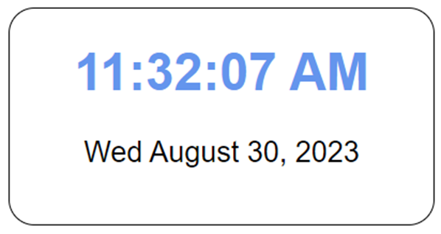
The Clock app

Slide 36
The <body> element for the Clock app
<body>
<h1 id="time"></h1>
<p id="date"></p>
<script type="importmap">
{
"imports": {
"DOM": "../general_modules/DOM.js",
"dayjs": "https://cdn.skypack.dev/dayjs@1.10.7"
}
}
</script>
<script src="clock.js" type="module"></script>
</body>

Slide 37
The clock.js file
import {load, setText} from "DOM";
import dayjs from 'dayjs';
const displayClock = () => {
const time = dayjs().format('h:mm:ss A');
const date = dayjs().format('ddd MMMM D, YYYY');
setText("#time", time);
setText("#date", date);
};
load(() => {
displayClock();
setInterval(displayClock, 1000);
});

Slide 38
A closure
const createSlideShow = function() {
// private variables/constants
let timer = null;
let play = true;
let speed = 2000;
const nodes = {image: null, caption: null};
const img = {cache: [], counter: 0};
// private functions
const stopSlideShow = () => { ... };
const displayNextImage = () => { ... };
return { // a public object with three public methods
loadImages(slides) { ... },
startSlideShow(image, caption) { ... },
getToggleHandler(){ ... }
};
};

Slide 39
Create and use the slide show object returned by the function
// create the slideShow object
const slideShow = createSlideShow();
// call a public method from it
slideShow.loadImages(slides);

Slide 40
An immediately invoked function expression (IIFE)
(function() { // define and invoke function
console.log("Hello"); // in one statement
})();

Slide 41
The module pattern
const slideShow = (function() {
// private variables/constants
let timer = null;
let play = true;
let speed = 2000;
const nodes = { image: null, caption: null };
const img = { cache: [], counter: 0 };
// private functions
const stopSlideShow = () => { ... }
const displayNextImage = () => { ... }
return {
// public methods
loadImages(slides) { ... },
startSlideShow(image, caption) { ... },
getToggleHandler(){ ... }
};
})(); // creates the object

Slide 42
Use the slide show object defined by the module pattern
slideShow.loadImages(slides); // call a public method

